Slide 1
First Term Success Workshop
Resources and Links
Notes:
FACILITATOR GUIDE:
The Navy has ensured that a variety of resources are available to all Sailors, use your resources and keep them accessible for you and your family.

Slide 2
Enabling Objectives
IDENTIFY U.S. Navy resources that aid in decision making
IDENTIFY U.S. Navy links that support Sailor's decision making
ASSESS U.S. Navy Apps available to support Sailors
Notes:
FACILITATOR GUIDE:
Review objectives

Slide 3
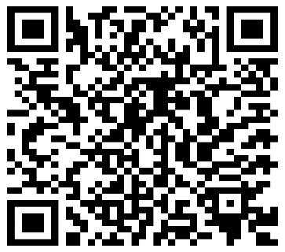
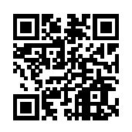
Resources & Links
My Navy Career Center (MNCC)
Phone: 833.330.MNCC (6622)
Email: askmncc@navy.mil
MilSuite (The Navy’s Social Media)
https://logincac.milsuite.mil/
Career Counselor Corner
https://www.mynavyhr.navy.mil/Career-Management/Career-Counseling/Resources/
Military OneSource
Notes:
FACILITATOR GUIDE:
Navigate to these sites (if possible) and explain the relevance of each.

Slide 4
Resources & Links
Cont…
BUPERS Online – Web Enabled Record Review (WERR), PRIMS
https://www.bol.navy.mil
My Navy Portal – Navy E-learning, Electronic Training Jacket, many useful links.
https://www.mnp.navy.mil/group/mnpmain/home
Electronic Service Record (ESR)
https://nsips.nmci.navy.mil
Notes:
FACILITATOR GUIDE:
Navigate to these sites (if possible) and explain the relevance of each.

Slide 5
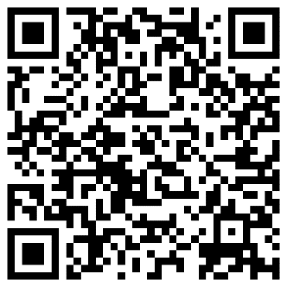
Resources & Links
Cont…
My Navy Assignment
https://mynavyassignment.navy.mil
My Navy HR
https://www.mynavyhr.navy.mil
Learning and Development Roadmap (LaDR)
https://www.cool.osd.mil/usn/resources_and_links/index.html?UnderstandingYourLadr
Notes:
FACILITATOR GUIDE:
Navigate to these sites (if possible) and explain the relevance of each.

Slide 6
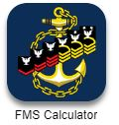
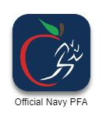



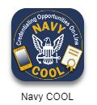
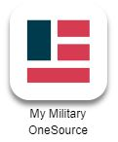
Useful Apps
Notes:
FACILITATORS GUIDE:
These Apps are available on both App Store and on Google Play.

Slide 7
Summary and Review
Resources and Links
Useful Apps
FTSW Pamphlet
Questions?
Notes:
FACILITATORS GUIDE:
This is the FTSW Pamphlet. It can be used a quick reference guide. It can also be found on MyNavyHR.

Slide 8
Knowledge Check
What website is a coverage for all items submitted to the Navy for review or processing?
What website can you use to receive free counseling i.e., mental assistance or financial guidance?
What website can be used to review your contract that was signed in MEPS and/ or bootcamp?
What is the website used to apply for your next set of orders once eligible?
What are the courses required to be taken for eligibility for the next paygrade E5-E6?
Notes:
FACILITATOR GUIDE:
Review questions with class. Feel free to add on desired.
Answers:
MyNavy Career Center (MNCC)
Military Onesource
BUPERS Online (BOL)
MyNavy Assignment (MNA)
Professional Military Knowledge Eligibility Exam (PMK-EE)

